Slide 1
Physics 2 – Mar 8, 2019
Get out p125 #1-12 for
HMK check
P3 Challenge – When a 350. g sample of an unknown metal at 85.0C is dropped into 480. g of water initially at 20.0C, the temperature of the water rises to 24.8C. What is the heat capacity of the metal? What is the likely identity of the metal?

Slide 2
Physics 2 – Mar 8, 2019
Today’s Objective:
3.1 Thermal Physics; Calorimetry
Assignment:
Extra Calorimetry Worksheet
Download Option B pdf
Agenda
Calorimetry
Homework Review
Answers only to Extra problems
Time to work on Extra Calorimetry WS for Answer alignment on WBs

Slide 3
Homework Answers
1. a) Yes, Q_{C}= - Q_{H} . Energy is conserved for the system. B) T_{C} = - T_{H} only if the same material. Generally the two T are probably different.
2. a) 513 J/kgC b) same
3. 2.78 J/gC or 2780 J/kgK
4. 4.16 J/gC
5. 71.7 C or 72 K
6. a) 116 kJ/K b) 86.3 min
7. 35 g (watch units!!)
8. 3.84 x 10⁸J or 384, 000 kJ
9. a) 83.5 min b) Assume no reflection of light energy from the ice.
10. a) 22 kJ b) 334 kJ c) 41.8 kJ d) melting needs the most energy
11. 0.111 kg or 111 g
12. Hint: Assume the final temperature will be greater than 30C because of the large value of L_{v}.

Slide 4
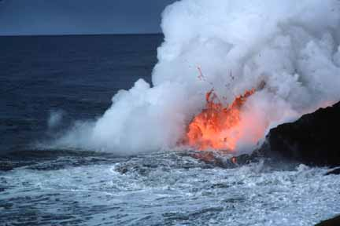
Extra Calorimetry Problems Answers only
1. 900 J/kgK Al
2. 42.9 kJ
3. 23.5C
4. 87.1 kJ
5. 52.8 kJ
6. 647 g
7. 109 J/kgK
8. 17.4 kg
9. 57.5C
10. 51.1C
11. 29.1 kg

Slide 5
General Problem solving approach
Draw picture. Label hot and cold parts to determine flow of energy.
Create equation for amount of energy lost by hot items = amount of energy gained by cold items.
Use mL or mcT or Pt or mgh or other way to calculate J for each part.
Substitute known values WITH UNITS. Change units as needed so they will cancel.
Drop the units and use just numbers for the equation to help solve.
Find your answer.

Slide 6
Heat during Phase changes
For the constant temperature phase changes, Q = mL
Where L is the specific latent heat of fusion for melting and freezing and
Or where L is the specific latent heat of vaporization for boiling and condensation.
The unit for L is J/kg or kJ/kg or J/g
Note the similarity between this equation and Q= mcT.

Slide 7
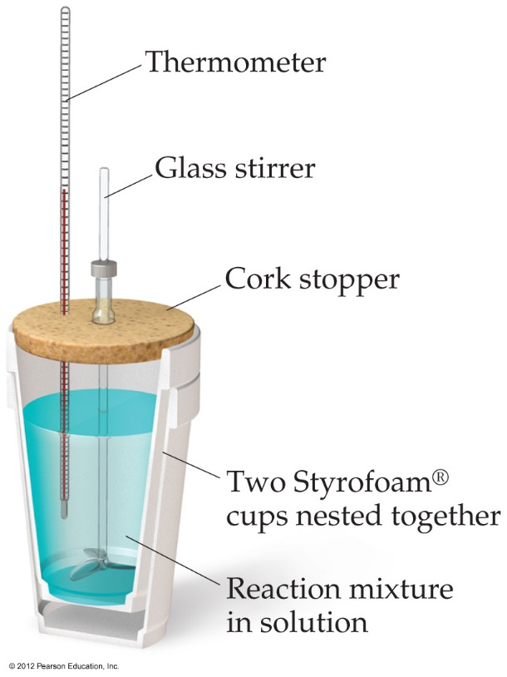
Calorimetry (method of mixtures)
Calorimetry is the measurement of heat.
In general, with any kind of calorimetry, there is some hot substance giving off heat and something else picking up that heat.
The amount of heat lost by the hot object = amount of heat gained by the cold object.
Either |Q_{c}| = |Q_{H}| or Q_{c}= - Q_{H}
Or to say it another way, the energy of the total system is conserved. Q_{c}+ Q_{H} =0
water

Slide 8
Calorimetry problem
A 525 g lead ball at a temperature of 100.0☑C is placed in a 25.0 g aluminum calorimeter containing 587.6 g of water at 17.5°C. Find the equilibrium temperature of the system. (approx. 20°C)

Slide 9
Exit Slip - Assignment
Exit Slip- What’s Due? (Pending assignments to complete.)
Ch 3.1, p125, #1-12 Due Tuesday
What’s Next? (How to prepare for the next day)
Read 3.1 p116- 124 about Thermal Energy

